Slide 1
Jason Dietz, Sharmi Das and Ritu Nalubola
U.S. Food and Drug Administration

Slide 2
Challenges
People in our country have questions about the use of biotechnology in food production.
  Print and web content and social media posts sometimes provide inaccurate information.
  Consumers see labeled products and may believe it is an indication of safety or wholesomeness.

Slide 3
What did we do?
We developed an education and outreach initiative on agricultural biotechnology, mandated and funded by the U.S. Congress.
  The initiative is intended to publish and distribute science-based educational information on the environmental, nutritional, food safety, economic, and humanitarian impacts of such biotechnology.

Slide 4
What did we do?
We performed extensive formative research. This research included:
  Two public meetings
  Consultation with experts and specific stakeholder groups
  Review of the literature on communicating about this subject
  Focus group research with target audience

Slide 5
What did we do?
In developing our initiative, we committed to:
  using plain language that is easy for consumers to understand,
  providing science-based information, and
  being a neutral source of information (not promotional).

Slide 6
What did we do?
We launched the first phase of publicly-available materials from this initiative on March 4, 2020.
  Feed Your Mind
    Material is available in Spanish and English
We have promoted these materials through social media and a widely dispersed press release.

Slide 7
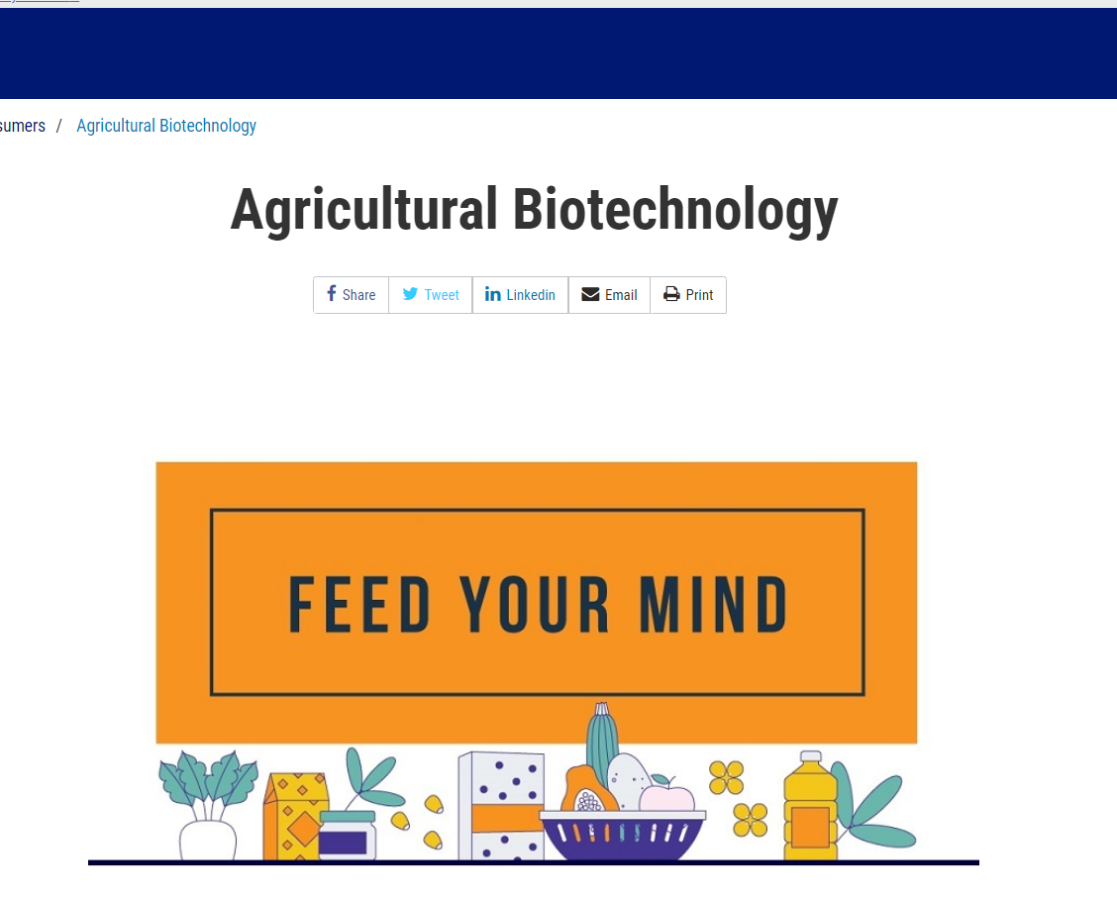
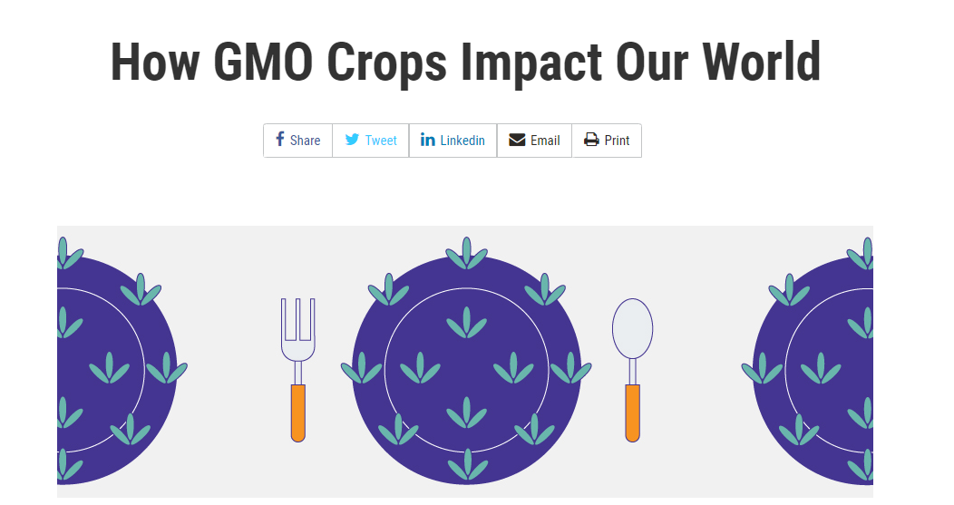

Slide 8
What worked? What didn’t?
As part of our effort we performed an efficacy study to see if our material was understood as expected.
  The study showed that consumers understanding of this issue increased after viewing our materials.
We are still evaluating what worked well and what we might do different in the future.
Key learning- We must continue to work to make sure our messages are simple and easy to understand . Although they may be simple to us as scientists, they may not be simple for the general public.

Slide 9
What do consumers need to know?
Need to know:
  These foods are safe and have been used for more than two decades.
  The safety of these products is reviewed by the government before marketing.
  Use of biotechnology is separate from use of herbicides, hormones and other agricultural processes.
  Which products are genetically engineered.

Slide 10
What do consumers want to know?
Want to know:
  Is this food nutritionally superior/inferior?
  Does this food have a harmful environmental impact?

Slide 11
Essential elements
These foods are safe and have been part of the global food supply for over two decades.
These foods are an important tool to ensure that everyone has enough to eat.
Consumer education and outreach mechanisms must use multiple formats (website, social media, videos, factsheets) and need to be credible, sustained and updated over time.

